Slide 1
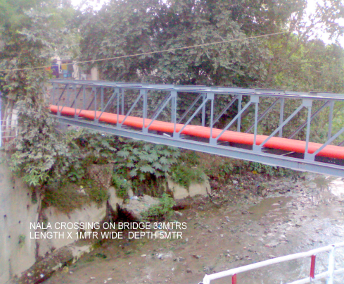
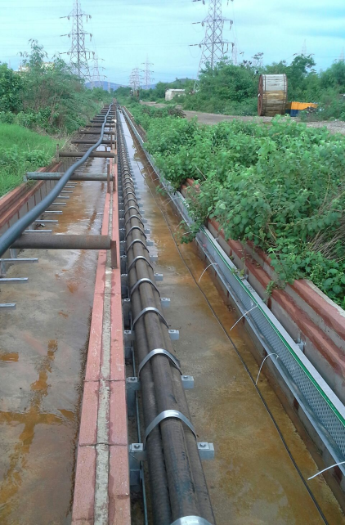
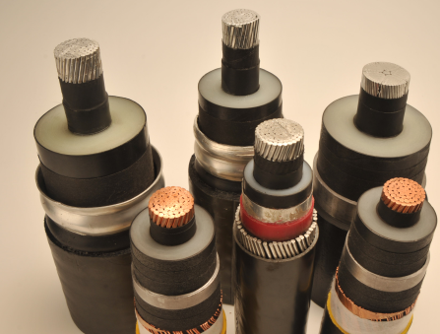
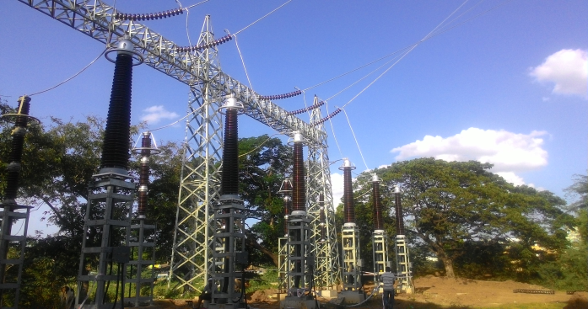
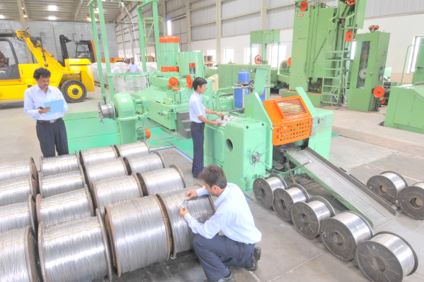
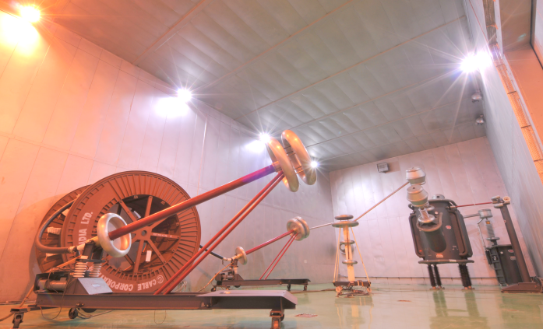
NALLA CROSSING
PGCIL PUDUCHERRY
RINL VSP VIZAG
BHEL/TNEB ALMATHY 230KV GANTRY
QUALITY CHECKS WIRE DRAWING
BIMETALLAIC SHIELDED ROOM
PD TESTING 410KV

Slide 2
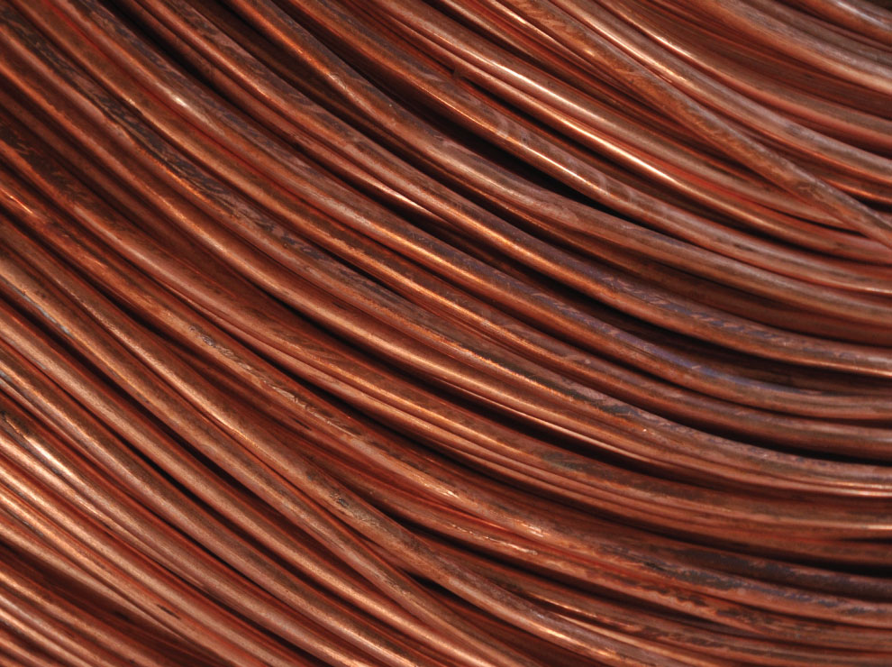
WELCOME

Slide 3
Corporate Vision
Corporate Vision
To be the company of choice in the power sector among quality conscious customers and stakeholders

Slide 4
Quality Policy
Quality Policy
We at CCI are committed for continual improvement of our Quality Management System, meeting the customer’s satisfaction along with enhancing and sustaining the company’s reputation for product quality at competitive prices in National and International markets.

Slide 5
Corporate Strength
Corporate Strength
Has played a leading role in import substitution by developing substitutes for Railways and Defense
Exports to various countries across the globe, conforming to various international standards
Only company in India to offer end to end solutions from concept to commissioning
Long and strong association with Siemens has positioned the company as the industry benchmark for premium quality
Long tradition of technological leadership and pioneering cable development in India
Strong brand pull – Tropodur has become a generic name for PVC cables
Nation-wide marketing network

Slide 6
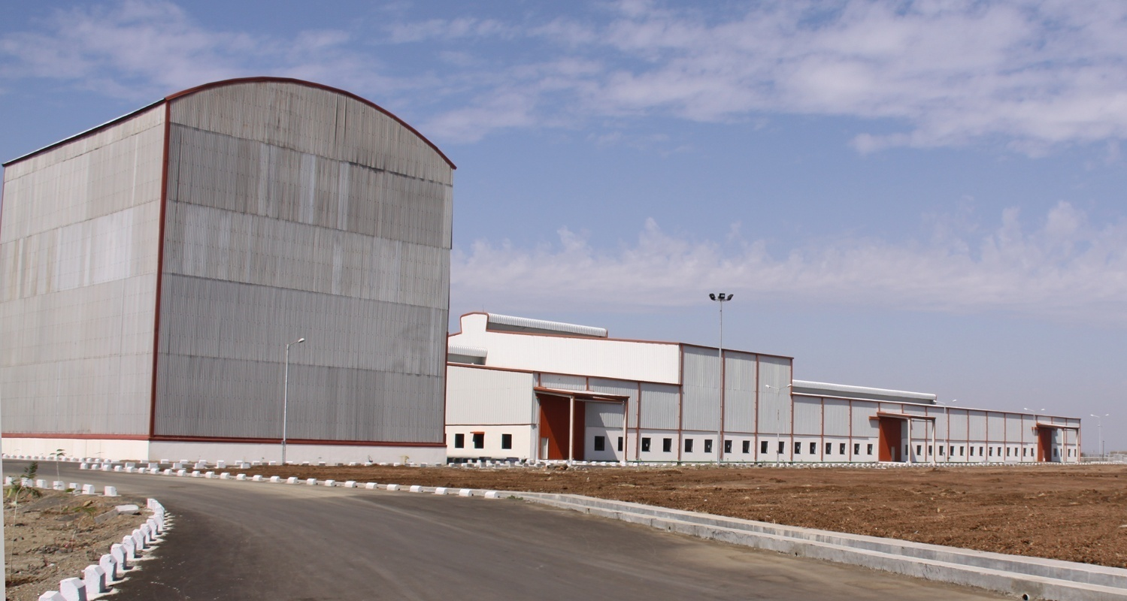
Bringing Quality Power Safely to the People
EHV TEST LAB

Slide 7
Company Background
Incorporated in 1957 by Siemens & Khatau family
Technology, production & quality systems of Siemens
Exclusive licensee of Siemens cable trademarks in India
Two fully integrated manufacturing plants located in Nasik, Maharashtra
First company in India with capability to manufacture 230 kV EHV cables
Offers ‘Total Cable Service’ from ‘Concept to Commissioning”

Slide 8
2015 |  | BHEL/TNEB/ PGCIL Bokaro /TNEB Guindy Kadaperi /NDPL - MADHUBAN CHOWK/SML ISUZU /VSP/ Ferry Estate/ Siemens Infocity Kochi 230KV 1400sqmm/ 1200sqmm/ 500 sqmm/132KV 300 CU SQMM more than 90 kms commissioned in 2015.
2014 |  | 220kV PQ Test completed; received 5 major orders from India Bulls, GETCO, BARC & MSETCL. Turnkey work for TPDDL; RRVPNL/PGCIL Puducherry orders . Commissioned 132kv/ 110kv 60 kms
2013 |  | Commissioned 70 kms of 66kV KPTCL, TNEB Addl order 230kV, TNEB Elephant gate 230kV Projects
2012 |  | TNEB Airport 110kV order commissioned 22.5 kms
2011 |  | Received 129 Km of 1x1200 Sq mm, 230 kV Turnkey order from TNEB
2010 |  | Shifted EHV Facilities to Nasik, adjacent to LV & MV Cable Plant
2009 |  | Executed120 Km 220 kV Cable order for TNEB
2007 |  | Manufactured ,supplied & Installed 11kV Submarine Cable at Bet Dwaraka
2004 |  | Supplied & installed 132 kV Cables below Gandhi Setu at Ganges
1993 |  | Successfully installed & commissioned 220 kV Cables – for TNEB
1992 |  | Successfully Type Tested 220 kV Cable at KEMA
1989 |  | Manufactured first 220 kV Cable – First time in India
1982 |  | First company outside Japan ( in Asia) to get license of manufacturing of EHV cables with MDCV line
72-79 |  | Started manufacturing of TROPOTHENE 33KV cables, Elastomer cables.
60-66 |  | TRPODUR (PVC) wires cables –First time introduced in Indian market. PILC cables
1957 |  | Year of incorporation of the company – promoted by Siemens AG, Khataus, Felten & Guillermo AG & Thackerseys

Slide 9
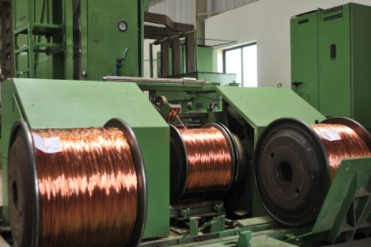
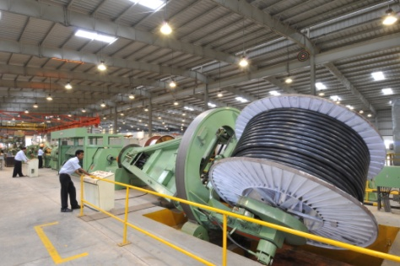
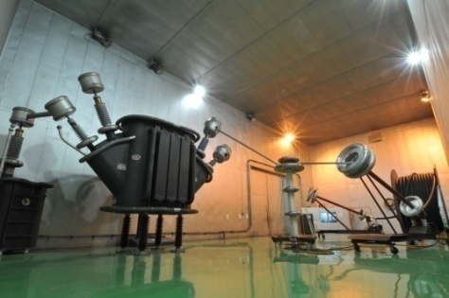
Total Cable Service:
From Concept to Commissioning
Provided Service Across All Industries
Forefront of development in the cable industry for 5 decades
Pioneers in the development of import substitutions for Railways, Naval and Defence applications
Successfully led a Govt. initiative of development of Aluminium as conductor instead of Copper, as well jointing and termination techniques in cables with Aluminium conductors.
The first to develop Electrical PVC FR/FRLS compounds
The first to develop HV & EHV cables

Slide 10
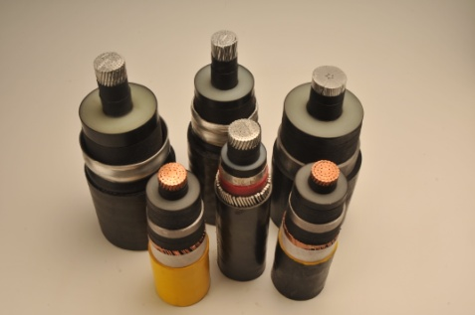
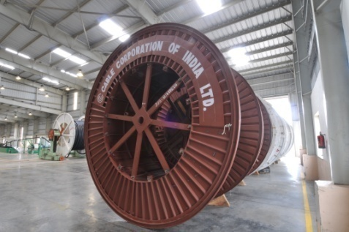
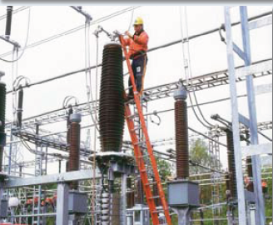
EHV Offerings
Total Cable Solution
Design and Supply of EHV Systems
Design, Manufacturing, Testing and Supply of Extra High Voltage XLPE Cables
Supply of Accessories
Installation of Cables and Accessories
Commissioning on Turnkey basis.
Max conductor size :2500 Sq.mm (Segmental)
Maximum Voltage Grade : 400 kV

Slide 11
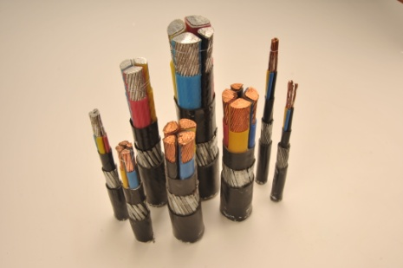
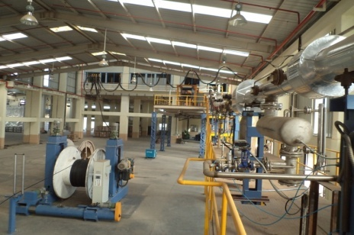
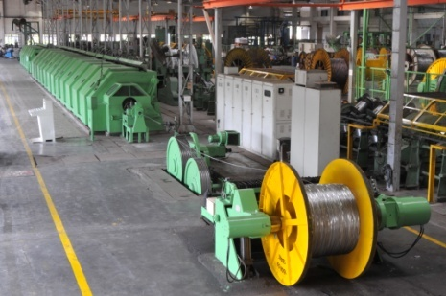
LV and MV Offerings
LV Cables
1.1kV Power & Control Cables with XLPE & PVC Insulation
Conductor Sizes : 1.5 mm² to 1000 mm²
Number of Cores :
Power Cables -1, 2, 3, 3½ & 4 cores
Control Cables – up to 91 cores
MV/HV Cables
3.3 kV to 33 kV Grade XLPE Cables
Dry Cure Process
Conductor sizes: 25 mm² to 1000 mm²
Single Core Cables up to 1000 mm²
3 Core Cables up to 400 mm²

Slide 12
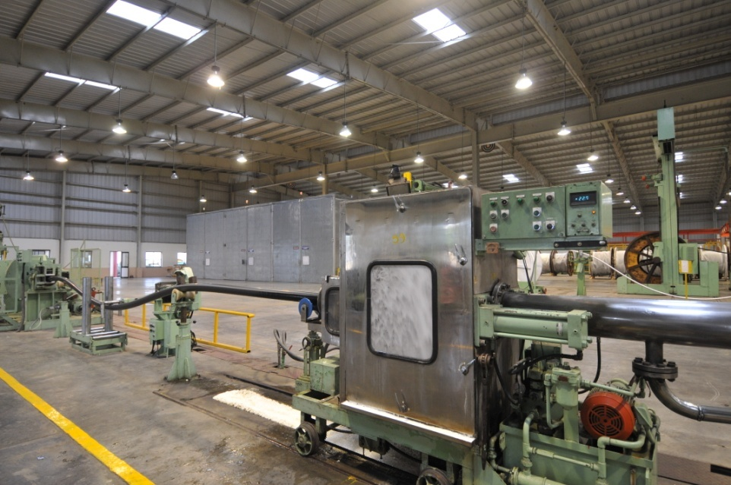
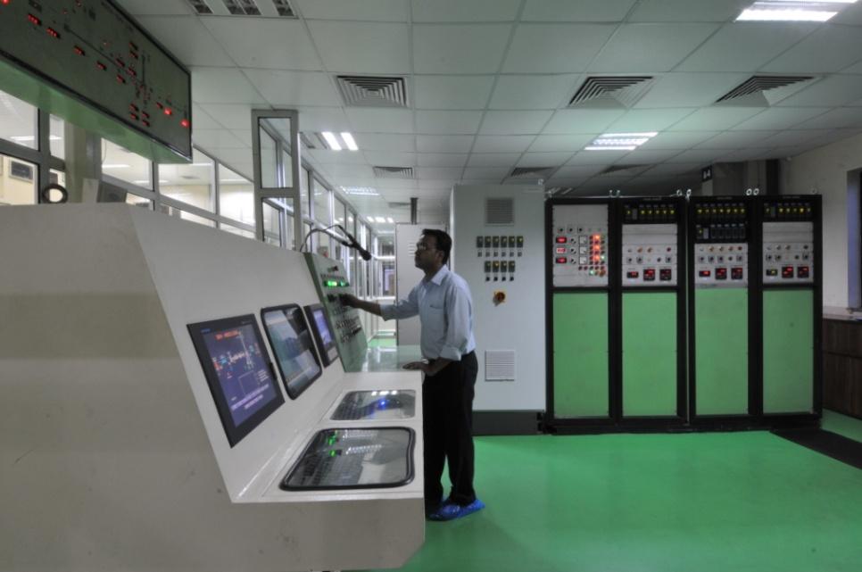
MDCV Process
Clean Room
MDCV Line

Slide 13
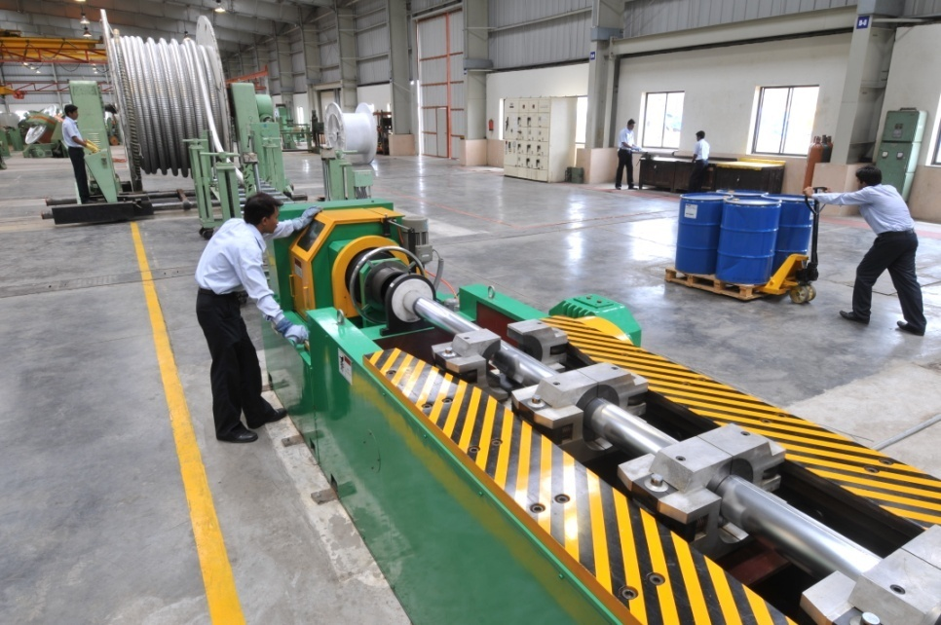
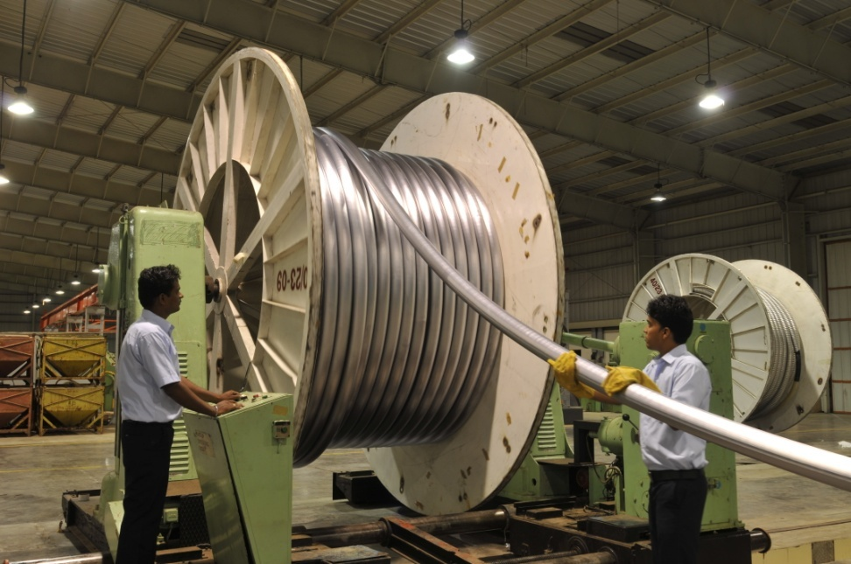
Metal Sheathing Lines
Aluminium Sheathing Line
Lead Sheathing Line

Slide 14
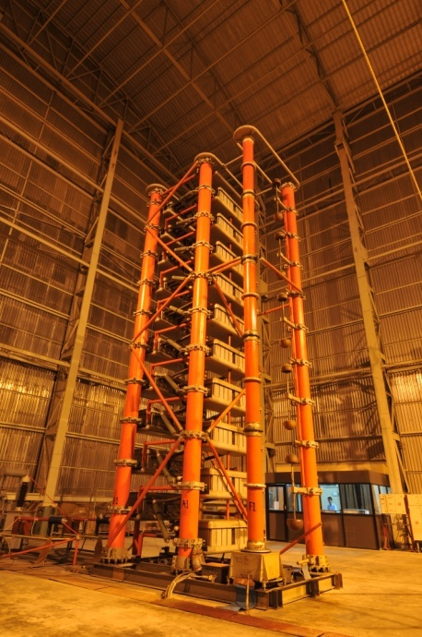
EHV Testing Facilities
Testing facilities are available for all tests - Raw Materials testing as well as Finished Cables Testing as per National & International Standards
High Voltage and Partial Discharge Equipment
400kV Series Resonant Test system
Double wall shielded room imported from USA.
Impulse Equipment
2500 kV Impulse Generator Suitable for Lighting Impulses 1.2/50 Micro Seconds
Heat Cycle Equipment
30 V, 4000 amps, 120 KVA, Current Transformer
Can perform Heat Cycle test as per IEC 60840 & IEC 62067 in combination with High Voltage set
DC High Voltage Equipment
400 kV DC Generator Suitable for after installation tests on cables up to 220 kV

Slide 15
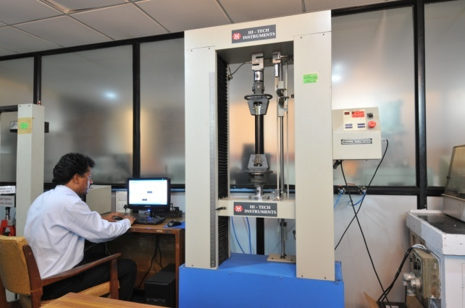
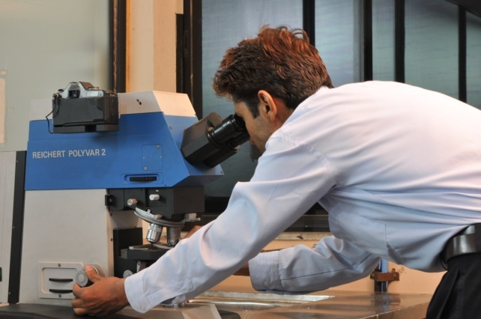
R&D Laboratory
Toxicity index equipment
Digital infrared spectrophotometer
Gas chromatograph
Differential scanning calorimeter
Thermo Gravimetric Analyzers
Karl Fischer Coulometer
Capacitance and Tan Delta Bridge

Slide 16
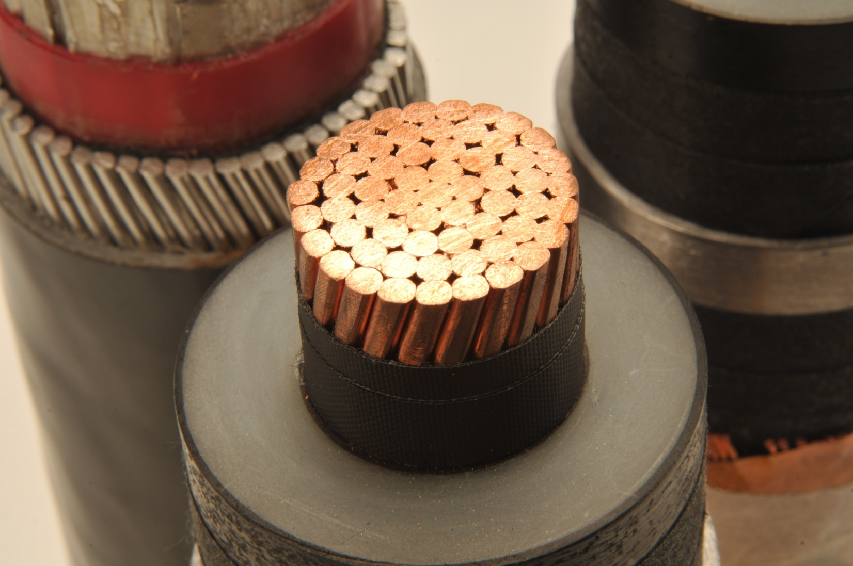
Product Range
Lead sheath copper
wire screen EHV cable
Aluminium Armoured XLPE cable
Copper conductor Al sheathed EHV cable

Slide 17
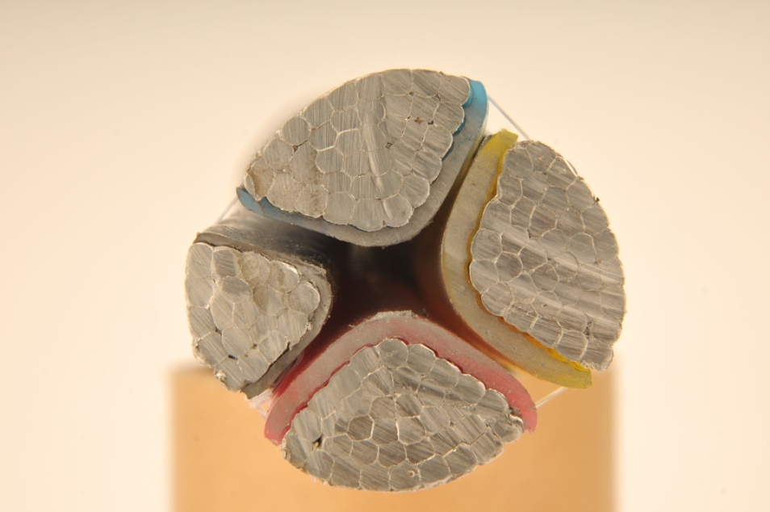
LV Tropodur®
Conductor size up to 1000 mm², Al & Cu
Uses well known Tropodur PVC compound formula
No impregnating compounds
Can be laid vertically
Flame retardant
Resistant to most alkalis & acids

Slide 18
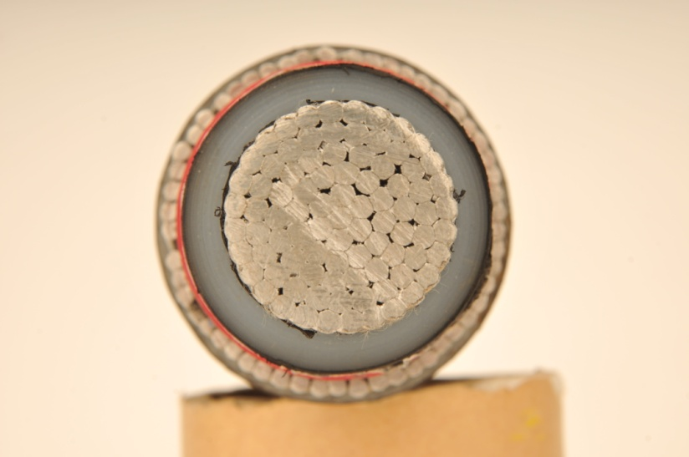
Product Range
LT - PVC
MV Tropothene®
Conductor size up to 1000 mm², Al & Cu
Manufactured using Dry Cure process in a CCV line
High conductor operating temperature
Low dielectric loss and charging currents
Tropodur formula for PVC inner and outer sheaths

Slide 19
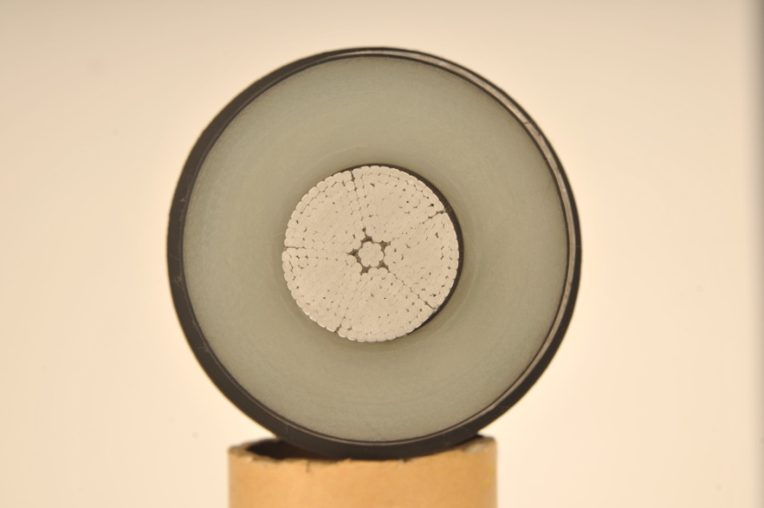
EHV Tropothene S®
Mitsubishi’s MDCV process provides superior properties
Core size up to 2500 mm², Cu & Al
Can offer Al, Pb and Poly-Al sheathings
Can design and manufacture Milliken conductor cables
Void free extrusion due to high curing temperature & pressures
First Indian source for 230 kV cables

Slide 20
Product Range
LT - PVC
Speciality Cables
Spreader cables for container cranes
Cables for seismic & under sea applications
Zero halogen fire survival cables
Cables for mine sweeping applications
100 KV DC cables

Slide 21
Recognition & Certification
Recognition & Certification
First cable company in India to get ISO 9001
Approvals from NV KEMA, Netherlands, CPRI, India, FGH, Germany and CESI, Italy
Approvals against various international standards such as IEC, BS, Swedish and IEEE
Representation in CIGRE, Paris for development of EHV cable specifications and technology

Slide 22
Services Offered
Design and supply of power and control cables to various Indian and International standards
Supply of cable accessories, jointing and termination kits
Design, erection and commissioning services for cable systems
Total project and turnkey services

Slide 23
EHV Credentials
Supplied around 500 km of EHV cables of different voltage grades (66kV-220 kV) to various utilities and Industry customers, including exports.
Supplied approximately. 180 km of 220 kV, 1200 mm² segmental Aluminium conductor of size 1200 mm² cable to TNEB.
Supplied 36km 132kV, 1x800 mm², XLPE Cable to RRVPN and commissioned in 2014.
Received 3 orders from PGCIL for 110kv, 220kV cable turnkey projects. Two projects completed and commissioned.
Third project started.
Received 220kV orders from MSETCL, GETCO, India Bulls and132kV order from BARC
Notes:
TATA POWER SAFETY CERTIFICATE

Slide 24
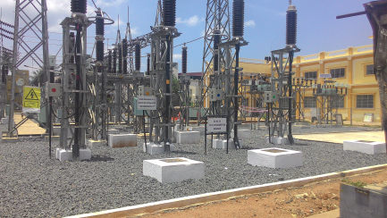
EHV Credentials – some projects completed
BPCL 432 Lacs Submarine Cable repairing job over and commissioned on 23-05-2015
TNEB 230 KV - Guindy/Kadaperry 4,152 Lacs commissioned on 16-04-2015 -230KV 1200sqmm Al Cond Lead sheath. Route length 13.625Km; Cable Qty - 40.875Km
TNEB 230 KV – Elephantgate / Mylapore 3,350 lacs commissioned on 19-10-2013 - 230KV 1200sqmm Al Cond Lead sheath. Route length 12.225Km; Cable Qty - 36.765Km
NDPL - Madhuban Chowk 713 Lacs commissioned on 31-03-2015
66KV 1000sqmm Al Cond Al sh cable. Route length-2.67Km; Cable Qty- 16.02Km

Slide 25
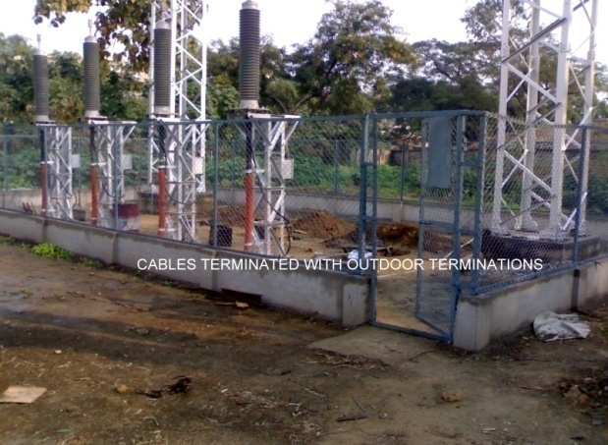
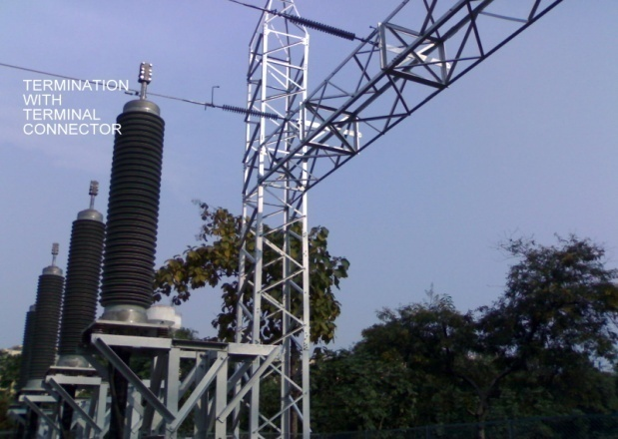
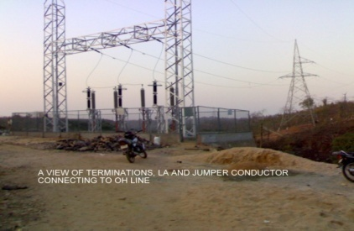
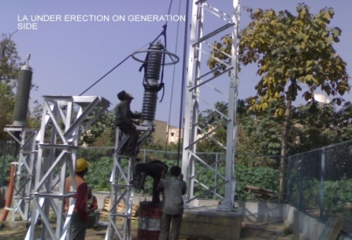
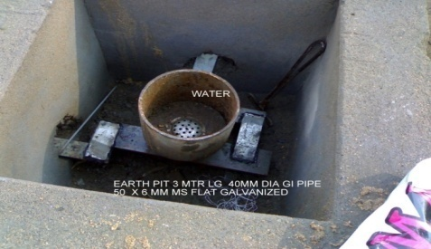
Product Range
LT - PVC
EHV Project Services
CCI has its own T&P for erection works and Project execution departments in various regions
Route surveys, soil testing and site feasibility study
Overseeing excavation and erection - preparation
of trenches / trays as per specifications
Laying of Cables in trefoil / flat using winches and
roller as per site requirement
Cable Jointing & Terminations work by qualified
jointers
Final Testing and Commissioning
EARTHING

Slide 26
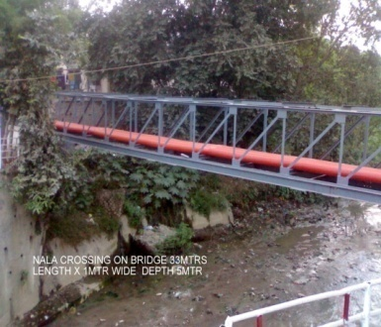
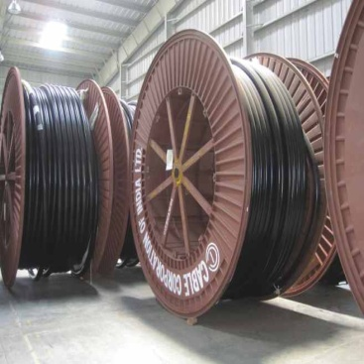
EHV Credentials
Pioneers in 220 kV XLPE Cables in India.
The first 220 KV cable manufactured in 1993 and Type tested at KEMA Netherlands.
The first 220 KV cable supplied to TNEB in 1994 is in satisfactory operation till date.
PQ TEST done on 230kV cable at CESI LAB.
Type tested 66 kV, 110 kV, 132kV & 230 kV Cables in CPRI Bangalore

Slide 27
EHV PROJECTS
BHEL TNEB
PGCIL PUDUCHERRY
VSP VIZAG
Notes:
PGCIL BOKARO PHOTOGRAPHS TO BE INCLUDED AND LABELLED BHEL ALMATTY

Slide 28
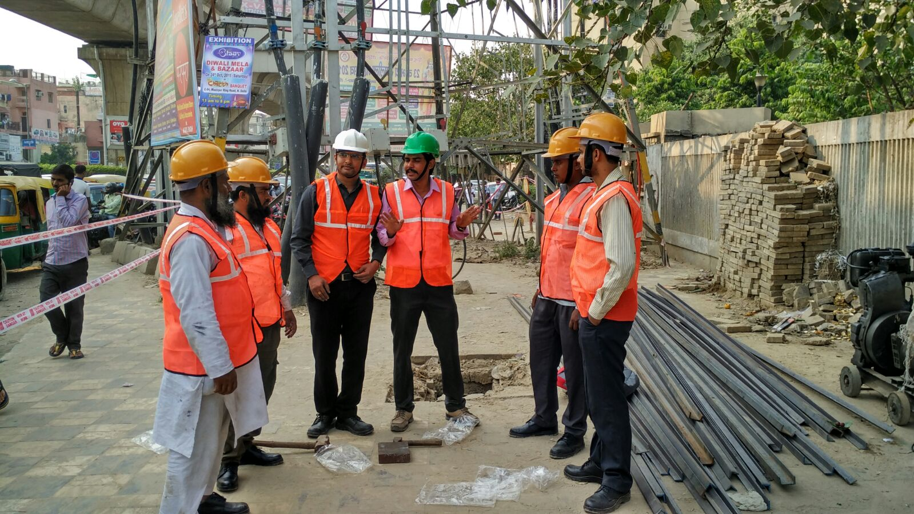
SAFETY MEETING
THANK YOU
Notes:
T&P AVAILABLE WITH CCI ROLLERS AC CABIN TOOLS OF ACCESSORIES SAFETY MEETING PHOTOS FROM PRASAD

Slide 29
Customers
State Utilities
APSEB, TNEB, KPTCL, KSEB, MSEB, BSEB, WBSEB,GEB, PSEB, HSEB,RRVPNL
GETCO, HVPNL
State Utilities
Private Utilities
Private Utilities
TCS INFOSYS
Contractors
Contractors
Government Bodies
Government Bodies
HPCL
BPCL
Other Companies
Other Companies
TISCO

Slide 30
SAFETY MEETING
THANK YOU
Notes:
T&P AVAILABLE WITH CCI ROLLERS AC CABIN TOOLS OF ACCESSORIES SAFETY MEETING PHOTOS FROM PRASAD

